Slide 1
Lesson 2 – Github flow

Slide 2
How it works IRL
development, devops and qa engineers are using at least one git repository for collaboration
everybody’s making mistakes and code-blocking each other, the work requires some additional control and coordination
the options are either to oversee each step of each team member or to establish a simple and unambiguous process of collaboration, usually called a flow

Slide 3
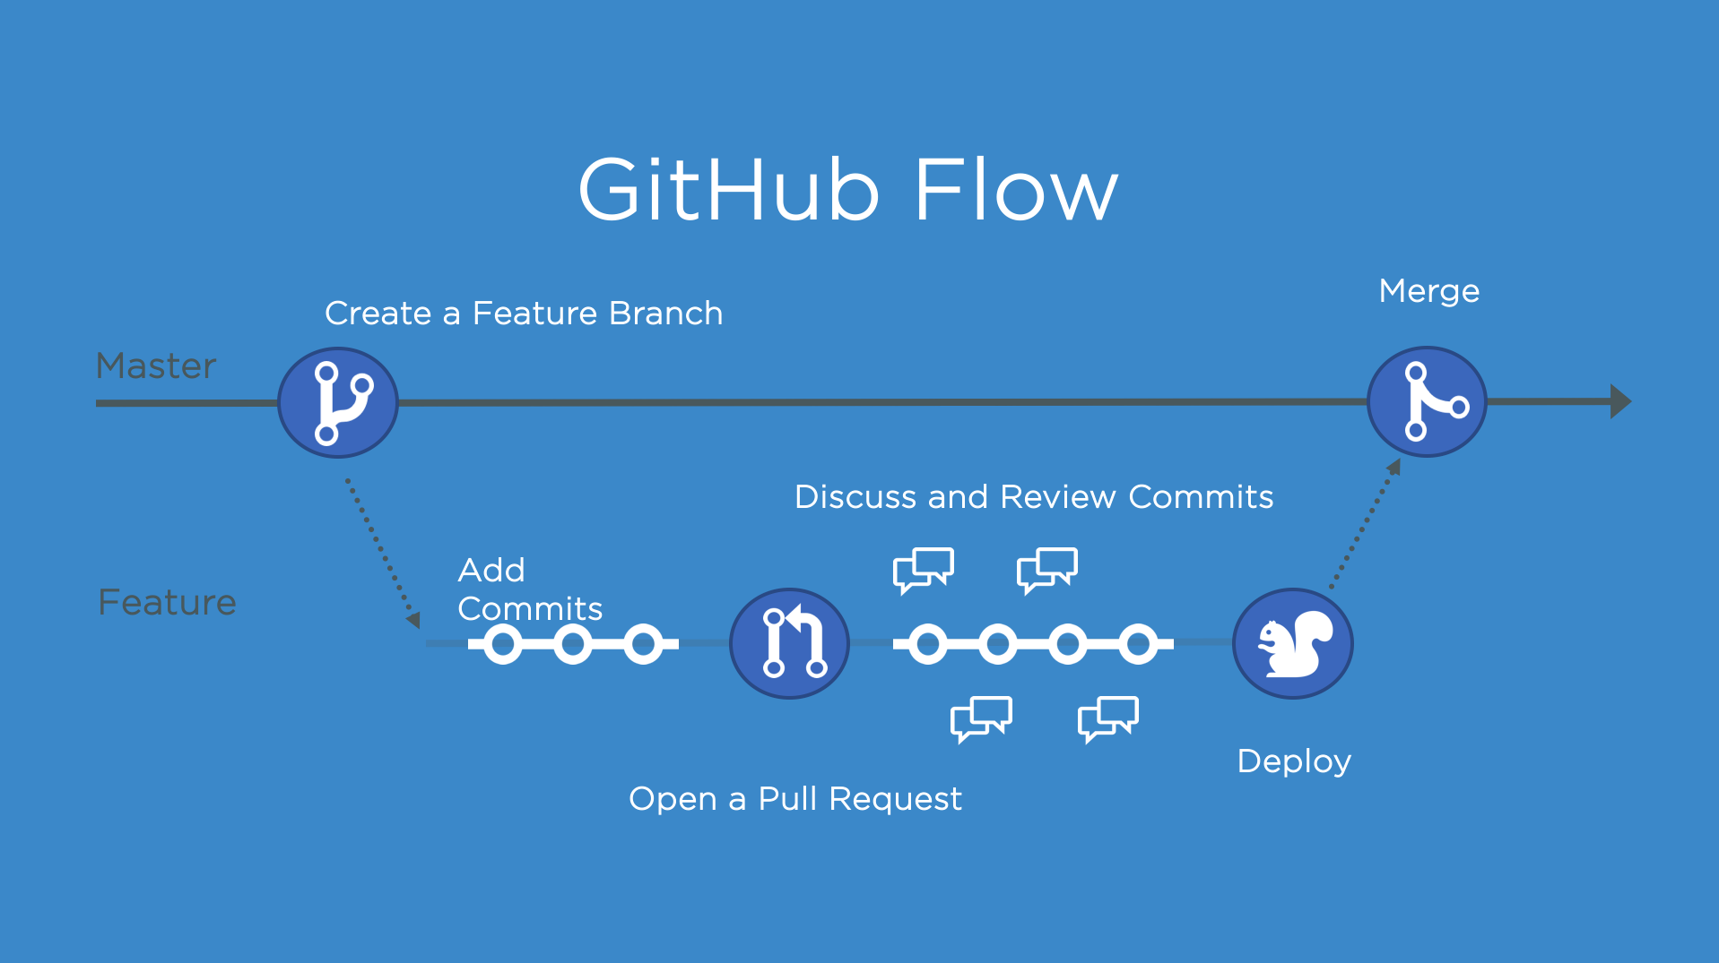
Github flow https://docs.github.com/en/get-started/using-github/github-flow
switch to master and pull
create a new branch
make some changes
create pull request (PR)
wait for a review
address comments, rework in the same branch (hence, same PR)
merge approved PR or wait for the owner to merge

Slide 4
OUR repo
https://github.com/MikitaTsiarentsyeu/highres24.git
everybody should be a collaborator (ping me to add you)
everybody works in one repo, no forks!
nobody except for the owner has rights to push to master, you can try, but it will result in error, don’t worry, it’s normal; just work according to the GitHub flow

